Slide 1



„Behavioral Tagging“ with novel virtual environments: a way to improve memory in children with ADHD
Valentin Baumann, Thomas Birnbaum, Jana Tegelbeckers, Carolin Breitling, Hans-Henning Flechtner, Kerstin Krauel

Slide 2
Interdisziplinärer Ansatz
Clinical approach
(human)
Cellular approach
(animal)
Behavioral
approach
(animal)

Slide 3
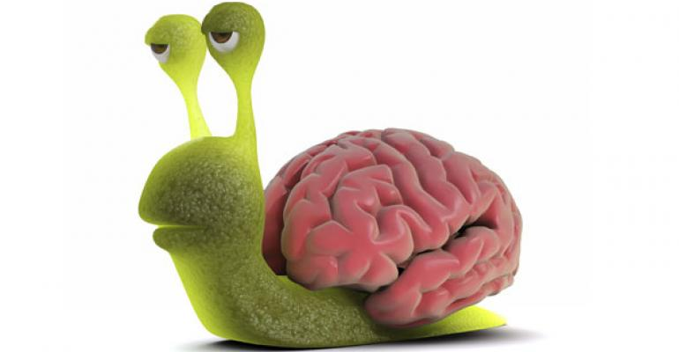
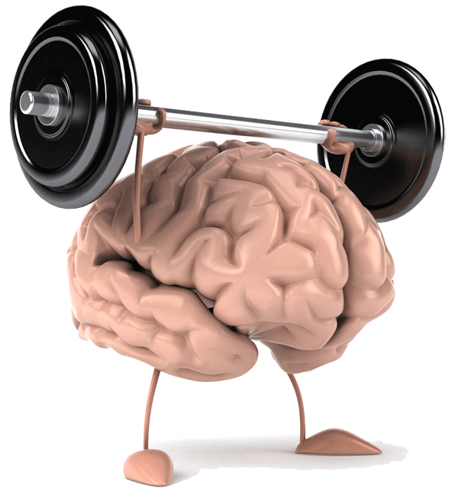
Behavioral Tagging
Learning Stimulus
„Weak event“
“Strong event“
Moncada et al., Neural Plast. (2015)
Notes:
first of all: BT assumes, that everything we learn (every „learning stimulus“) is either a weak or strong event
A weak event menas that the stimulus will be encoded, but not consolidated (so we can observe STM, but not LTM)
On the other hand, a strong learning is a learning stimulus that is salient enough to survive consolidation
So far so simple
BT now does something very interesting: by adding something (a certain behavior, thats why ist called BT) we can help the weak learning event to reach LTM like a strong event would
And this something…

Slide 4

Behavioral Tagging
Learning Stimulus
+
„Weak event“
Moncada et al., Neural Plast., (2015)
Notes:
…is novelty – the experience of something new
-> important: learning event and novel event are different things!
Not: you learn something new
But: there is something new, then you learn something else, and together this results in a strong memory,
We dont change anything about the learning stimulus
And in theory, this makes it a very powerful tool to improve the memory of any weak learning event (boring history facts, german vocabluary…)
-> THIS is the basic principle behavioral tagging
So far so good, but how is this supposed to work?

Slide 5

Behavioral Tagging in humans
Ballarini et al. (2013): Presentation of a novel school lesson

Slide 6
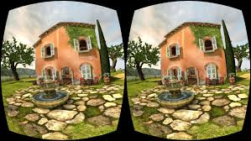
Behavioral Tagging in humans
Ballarini et al. (2013): Presentation of a novel school lesson
Schomaker et al. (2014): Exploration of a new virtual environment

Slide 7
What we do…

Slide 8

The Mansion

Slide 9

The Island

Slide 10






Day 1
Day 2
Day 3
Familiarization
Learning
LTM
STM
+ 45 min

Slide 11
Effect of novelty on consolidation

Slide 12
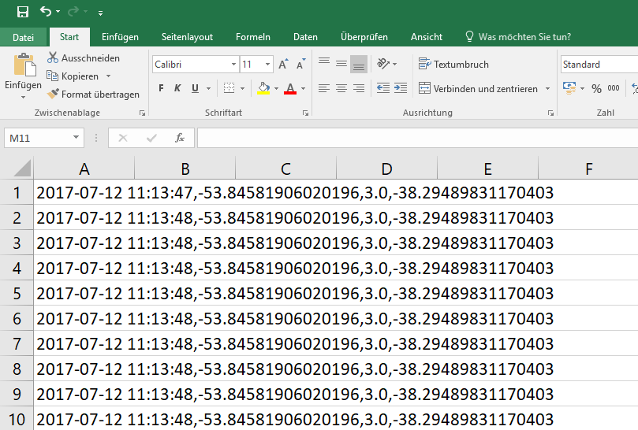
63 Probanden á 2 Explorationen = 126 Datensätze

Slide 13
Controls
ADHDs
familiar
novel
novel
familiar
Gleicher Tag, gleiche Welt, gleiche Gruppe, gleiche Novelty-Bedingung:
Jeweils ~ 5 Datensätze

Slide 14
Controls
partially novel
partially novel

Slide 15
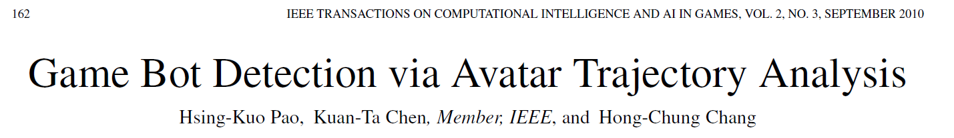
Exploration Variables:
Time, Distance, Speed
Lingering/Stopping
Smoothness (straight vs. zig-zag)
Detours
Angles/Trajectories
...

Slide 16
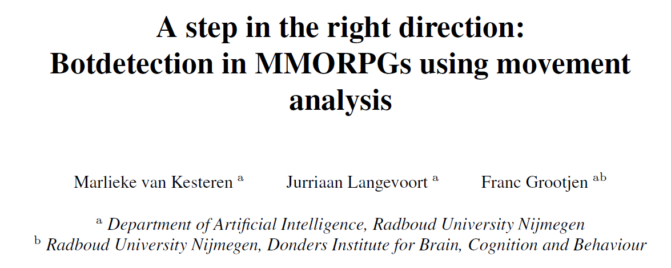
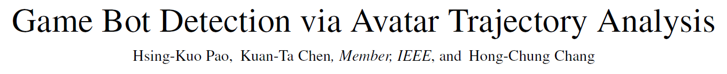

Exploration Variables:
Time, Distance, Speed
Lingering/Stopping
Smoothness (straight vs. zig-zag)
Detours
Angles/Trajectories
...

Slide 17
Additional Variables:
Age, Sex, IQ, working Memory, Attention…
Diagnosis (Healthy, ADHD, ADHD Subtypes)
Memory
Novelty Seeking
Immersion
Familiarity with Minecraft/Computer Games in general
...

Slide 18
Problems:
no real goal
no fixed time
different levels of experience controlling the avatar
different movement speeds possible („sprint“ vs normal walking)

Slide 19

Notes:
→ Warum kein Effekt für die Kontrollkinder?

Slide 20

Vielen Dank für Ihre Aufmerksamkeit!
www.kkjp.ovgu.de
valentin.baumann@med.ovgu.de

Slide 21
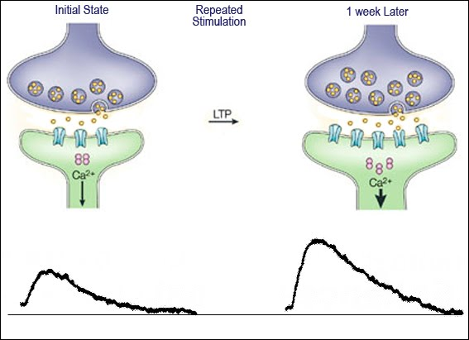
Zelluläres Lernen: LTP
T 1
T 2

Slide 22
Zelluläres Lernen: LTP
T 1
T 2
Dopamin

Slide 23
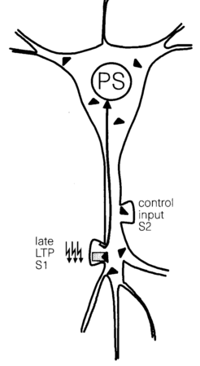
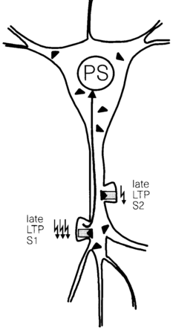
Synaptic Tagging and Capture

Slide 24
Retroactivity
Learning
Stimulus
Novelty
Novelty
Time

Slide 25
Short Term Memory
Notes:
sig. main effect of time
time * ADHD * novelty p = .163

Slide 26
Long Term Memory
Notes:
sig. main effect of time
time * ADHD * novelty p = .163

Slide 27
Diagnostics
Klinische Diagnostik: K-SADS-PL, CBCL, YSR, DISYPS
Aufmerksamkeitsdiagnostik: TAP, D2
Intelligenzdiagnostik: CFT-20-R
Gedächtnisdiagnostik: VLMT
Notes:
Kiddie Schedule for Affective Disorders and Schizophrenia (K-SADS) present + lifetime
Child Behavior Checklist (CBCL)
Youth Self Report (YSR)
Testbatterie zur Aufmerksamkeitsprüfung (TAP)

Slide 28
Literatur
Ballarini, F., Martínez, M. C., Díaz Perez, M., Moncada, D., & Viola, H. (2013). Memory in Elementary School Children Is Improved by an Unrelated Novel Experience. PLoS ONE, 8(6).
Moncada, D., & Viola, H. (2007). Induction of Long-Term Memory by Exposure to Novelty Requires Protein Synthesis: Evidence for a Behavioral Tagging. The Journal of Neuroscience, 27(28), 7476–7481.
Otmakhova, N., Duzel, E., Deutch, A. Y., & Lisman, J. (2013). The hippocampal-VTA loop: the role of novelty and motivation in controlling the entry of information into long-term memory. In Intrinsically motivated learning in natural and artificial systems (pp. 235-254). Springer, Berlin, Heidelberg.
Schomaker, J., van Bronkhorst, M. L. V, & Meeter, M. (2014). Exploring a novel environment improves motivation and promotes recall of words. Frontiers in Psychology, 5(AUG), 1–6.

